Slide 1

Introduction to Pharma
Major Disease Area Overview: Cardiovascular Disease
2013

Slide 2
Major disease area overview: Do’s and Don’ts
Do
Don’t
Do go through the training even if you aren’t staffed on a relevant project to build a solid foundation
Do use the material as background information and reference
Do not use the information directly without checking for more recent, updated documents (e.g. journals, treatment guidelines)
Materials are from previous projects which can be out-of-date
Do not copy slides directly for projects, project reports should be customized

Slide 3
Major disease area overview - Cardiovascular
Hypertension
Dyslipidemia
Thrombosis
Coronary Heart Disease
Stroke

Slide 4
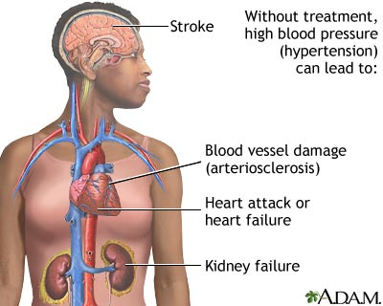
Hypertension is a chronic condition with elevated blood pressure; it rarely shows symptoms and is mainly identified through screening
HYN
Signs and symptoms
Disease definition
HYN (HTN) or high blood pressure, sometimes called arterial HYN, is a chronic medical condition in which the blood pressure in the arteries is elevated
Normal blood pressure at rest is within the range of 100-140mmHg systolic (top reading) and 60-90mmHg diastolic (bottom reading). High blood pressure is said to be present if it is persistently at or above 140/90 mmHg
Signs and symptoms
Classic symptoms: HYN is rarely accompanied by any symptoms, and its identification is usually through screening
Hypertensive crises can present as hypertensive urgency or as a hypertensive emergency
Hypertensive urgency: blood pressure is severely elevated [>=180/110mmHG], but there is no associated organ damage. Symptoms include severe headache, shortness of breath, nosebleeds, severe anxiety
Hypertensive emergency exists when blood pressure reaches levels that are damaging organs. The consequences of uncontrolled blood pressure can be severe and include stroke, loss of consciousness, memory loss, heart attack, damage to the eyes and kidneys, loss of kidney function, aortic dissection, angina, pulmonary edema, eclampsia
Source: IMS Consulting; American Heart Associations

Slide 5
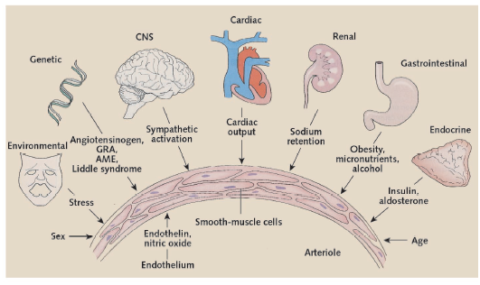
The causes of hypertension remains unclear while activation of the sympathetic nervous and renin–angiotensin–aldosterone system is regarded as the major pathophysiologic mechanisms
HYN
Causes and Pathophysiology
Causes
Pathophysiology
>90% of HYN do not have a clear cause
The exact causes of high blood pressure are not known, but several factors and conditions may play a role in its development, including
Smoking
Being overweight or obese
Lack of physical activity
Too much salt in the diet
Too much alcohol consumption
Stress
Old age
Genetics
Family history of high blood pressure
Chronic kidney disease
Adrenal and thyroid disorders
HYN clusters in families and results from a complex interaction of genetic and environmental factors
The HYN-related genes identified to date regulate renal salt and water handling
Pathophysiologic mechanisms include activation of the sympathetic nervous and renin–angiotensin–aldosterone system
Endothelial dysfunction, increased vascular reactivity, and vascular remodeling may be causes, of blood pressure elevation; increased vascular stiffness contributes to isolated systolic HYN in the elderly
Source: IMS Consulting; WebMD; Pathogenesis of HYN

Slide 6
Hypertension can be classified into essential HYN with unclear causes and secondary HYN with identifiable causes
HYN
Classification and stage
Two Types of HYN
Essential HYN
Secondary HYN
Primary (essential) HYN is the most common form of HYN, accounting for 90–95% of all cases of HYN
The underlying cause cannot be determined
Secondary HYN results from an identifiable cause
Renal disease is the most common secondary cause
It can also be caused by endocrine conditions, such as Cushing's syndrome, hyperthyroidism, etc.
Other causes of secondary HYN include obesity, sleep apnea, etc.
Source: IMS Consulting; American Heart Associations

Slide 7
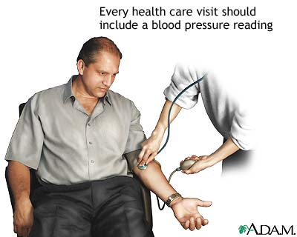
The diagnosis of hypertension is based on the level of blood pressure elevated
HYN
Diagnosis
HYN diagnostic criteria
If blood pressure is ≥140 mmHg systolic blood pressure (SBP) or ≥ 90 mmHg diastolic blood pressure (DBP), then the doctor will diagnose a patient as having hypertension
Traditionally, this requires three separate sphygmomanometer measurements at one monthly intervals
Initial assessment of the hypertensive people should include a complete history and physical examination
Classification | Systolic Pressure (mm Hg) | Diastolic Pressure (mm Hg)
Normal | < 120 | < 80
Pre-HYN | 120-139 | 80-89
HYN stage 1 | 140-159 | 90-99
HYN stage 2 | 160-179 | 100-109
HYN stage 3 | ≥ 180 | ≥ 110
Isolated systolic HYN | ≥ 140 | < 90
Source: IMS Consulting; China HYN treatment guideline 2006

Slide 8
Lifestyle modification and medication are two treatment methods
HYN
Treatment
Blood Pressure Stage
Diagnosis, classification and treatment of hypertension in China generally follows ESH-ESC guidelines (Europe)
Besides BP grade, risk factors contribute a lot on the product selection
Emphasis on personalized treatment: age, co-morbidities, organ damage, clinical events, contra-indications, factors considered
5 MOA treatments in single or combination are the main choices
Normal (S:120-139/D:80-89)
Mild (S:140-159/ D:90-99)
Moderate/ Severe
(S:>159/D:>99)
Lifestyle Modification
Mono Therapy
Combo Therapy
Fail
C8B:
CCB + Diuretics/others
C3A: Diuretics
C9A: ACE Inhibitors
C9D:
ARB+ Diuretics/others
C7A:Beta-blockers
C9C: ARB
C9B:
ACEI + Diuretics/others
C8A: CCB
C2A+C2B+C2C:
Other anti-HYNs
C7B:
Beta-blockers +others
Source: IMS Consulting;
Source: IMS Consulting; ishib.org - algorithmCard

Slide 9
Prospect of anti-HYN sub-TAs
HYN
Medication
Categories | Growth Prospect | Comment
Diuretics | Stable | Basic anti-HYN drug Usually combined with other anti-HYN drug Cheap
β-blocker | Stable | Low-medium HP reduction Interface glucose metabolism Usually combined with other anti-HYN drugs
ACEI (Angiotension Converting Enzyme Inhibitors) | Slow | Side effect: cough is difficult to control Pharmaceutical companies invest less on ACEI R&D BP reduction < ARB Organ protection supported by many evidence
ARB (Angiotensin II Receptor Blocker) | Continue rapid growth | New product Combination is high potential New indication Now strong evidence on heart protection
CCB (Calcium Channel Blocker) | Stable | Most powerful HP reduction Most stable HP reduction Usually prescribed for new patients No new product; less new indication
Traditional anti-hypertensive | Slow | Recommended as the first-line treatment but very cheap Most are old molecules Often prescribed to low-income patients or uninsured patients
Source: IMS Consulting; previous project experience

Slide 10
Hypertension patients are expected to continue to grow
HYN
Epidemiology
3
China hypertension prevalence rate (%)
Hypertension Patient Flow in China
18.2%
Adults (20 years of age or older) in China
(1334.7 Mn)
13.6%
5.1%
7.7%
Prevalence of hypertension in Adults:
18.2%¹
1959
1979
1991
2002
Future
Patients with hypertension
(242.9 Mn)
Hypertension Awareness and
Treatment Rate Trend in China
Medicine Treatment rate: 24.7%²
30%
27%
25%
Treated patient
(60.0 Mn)
12%
1991
1. The prevalence here is the average of several epidemiology study results
2. China residence nutrition and healthcare survey 2002; China CV disease report 2008-2009
2002
Awareness
Treatment Rate
Source: IMS Consulting; previous project experience

Slide 11
Though hypertension market is still prosperous, lack of innovative drugs makes the competition more fierce from generics
HYN
Market trend
China Hypertension patient base is very large and expected to further grow with aging population trend
The Hypertension population in China already reached a high level and hypertension prevalence is expected to continue to grow
Though the number of treated patients remain low, the awareness and treatment rate is rising
Similar to other countries, mono therapy is mainly recommended for mild patients while combo therapy is for more severe patients
CCB is currently the most commonly-used anti-hypertensive drug class, which is currently dominated by MNC, while strong local players are rising quickly
Though ARB gets usage constraints in NRDL, it still manages to become the fastest growing class in China
Market Growth
Hypertension Market
Market Segment
Pipeline
Leading Players
HYN combination is the R&D focus in the pipeline
MNCs are facing strong competitors in this fragmented market
Source: IMS past project experience

Slide 12
Major disease area overview - Cardiovascular
Hypertension
Dyslipidemia
Thrombosis
Coronary Heart Disease
Stroke

Slide 13
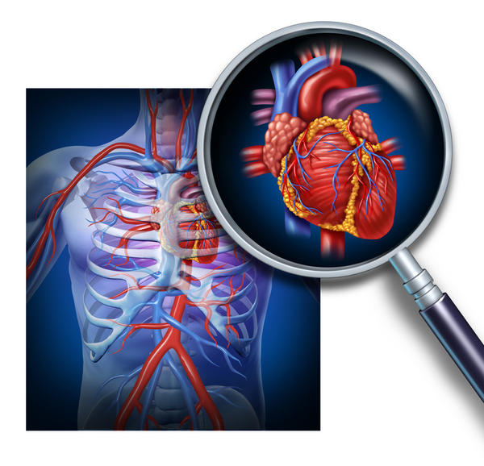
Dyslipidemia refers to abnormalities of lipoproteins; the most common dyslipidemias are hyperlipidemias
Dyslipidemia
Signs and symptoms
Disease definition
The term dyslipidemia refers to abnormalities in the composition, concentration, or size of lipoproteins in the circulation
Abnormalities seen in the clinical setting include elevation of the levels of any one of the following: low-density lipoprotein cholesterol (LDL-C), very low-density lipoprotein (VLDL), or triglycerides (TG), or a reduction in the circulating levels of high-density lipoprotein cholesterol (HDL-C)
Signs and symptoms
Dyslipidemia itself usually causes no symptom
Dyslipidemia can increase the risk of coronary artery disease (CAD) and peripheral arterial disease
Symptoms of CAD include angina and dyspnoea
Symptoms of peripheral arterial disease include intermittent claudication (pain, numbness, aching, or heaviness in the leg muscles during movement and/or cramping in the legs, buttocks, thighs, calves, or feet)
Very high levels of triglycerides (>11.29 mmol/L [>1000 mg/dL]) are a known but rare cause of pancreatitis in the general population
Source: IMS Consulting; myhivclinic, Metabolic Disorders Study, Decision Resources

Slide 14
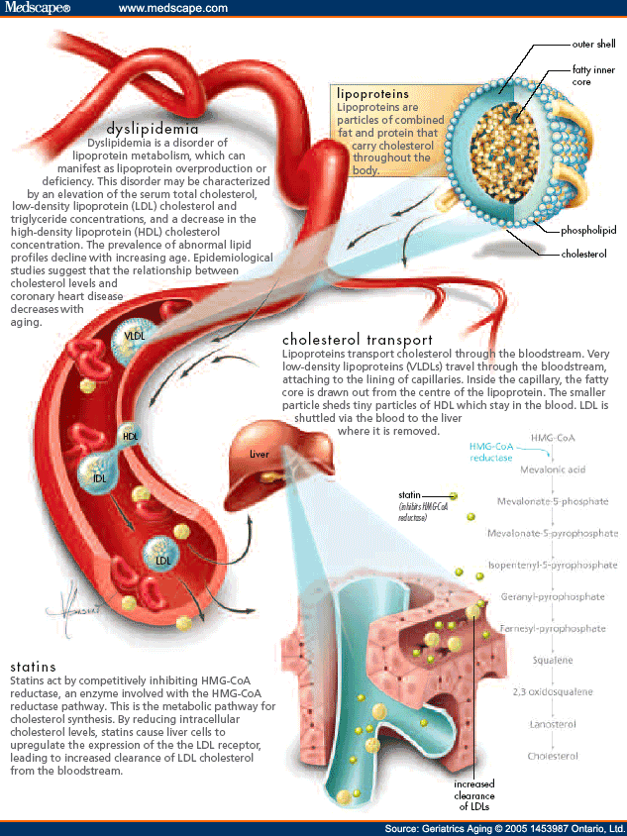
Both primary and secondary causes lead to dyslipidemia
Dyslipidemia
Causes and Pathophysiology
Causes
Pathophysiology
Primary Causes: Overproduction and defective clearance of the cholesterols TG and LDL is the result of the mutations of single or multiple genes
Secondary Causes: The causes contribute a lot on how an adult will be affected with dyslipidemia.
The sedentary lifestyle is the most essential secondary cause including excessive dietary intake of cholesterol, trans fats and saturated fats
Other causes: alcohol overuse, diabetes mellitus, hypothyroidism, chronic kidney disease, other cholestatic liver diseases and primary biliary cirrhosis, drugs like thiazides, retinoids, estrogens and glucocorticoids, among others
Source: IMS Consulting; The Lipid Management Resource Center

Slide 15
Dyslipidemia can be classified by phenotype and etiology and China guideline adopted a simplified version based on Fredrickson classification
Dyslipidemia
Classification and stage
Lipoprotein Patterns (Fredrickson Phenotypes, WHO version, primary)
Hyperlipoproteinemia |  | Synonyms | Defect | Increased lipoprotein
Type I | a | Buerger-Gruetz syndrome, or Familial hyperchylomicronemia | Decreased lipoprotein lipase(LPL) | Chylomicrons
 | b | Familial apoprotein CII deficiency | Altered ApoC2
 | c |  | LPL inhibitor in blood
Type II | a | Familial hypercholesterolemia | LDL receptor deficiency | LDL
 | b | Familial combined hyperlipidemia | Decreased LDL receptor and increased ApoB | LDL and VLDL
Type III |  | Familial dysbetalipoproteinemia | Defect in Apo E 2synthesis | IDL
Type IV |  | Familial hypertriglyceridemia | Increased VLDL production and Decreased elimination | VLDL
Type V |  |  | Increased VLDL production and Decreased LPL | VLDL and Chylomicrons
2007 China treatment guideline clinical classification of dyslipidemia
Classification | TC | TG | HDL-C | WHO classification equivalent
Hypercholesteremia | increase |  |  | Ⅱa
Hypertriglyceridemia |  | increase |  | Ⅳ,Ⅰ
Combined hyperlipidemia | increase | increase |  | Ⅱb, Ⅲ, Ⅳ, V
Low blood HDL cholesterol |  |  | decrease
Note: LDL = low-density lipoprotein; TGs = triglycerides; VLDL = very-low-density lipoprotein.
Source: IMS Consulting; American Heart Associations, 2007 China dyslipidemia treatment guideline

Slide 16
Diagnosis of dyslipidemia include serum lipid profile test and CV risk assessment; controlling CV events is regarded as the ultimate treatment goal
Dyslipidemia
Diagnosis
Treatment goal
Dyslipidemia level screening
Cardiovascular Risk Assessment
Control coronary artery disease(CAD) risk rather than purely adjust blood-lipid levels
Diagnosis is by measuring plasma levels of total cholesterol, TGs, and individual lipoproteins
Lipid measurement should be accompanied by assessment of other cardiovascular risk factors, defined as 1. Diabetes mellitus; 2.Cigarette use; 3. Hypertension; 4. Family history of CAD in a male 1st-degree relative before age 55 or a female 1st-degree relative before age 65
Lipid level standard
Group | TC | LDL-C | HDL-C | TG
Optimal | ＜5.18 mmol/L (200 mg/dl) | ＜3.37 mmol/L (130 mg/dl) | ≥l.04 mmol/L (40 mg/dl) | ＜1.70 mmol/L (150 mg/dl)
Borderline high | 5.18-6.19 mmol/L (200-239 mg/dl) | 3.37 - 4.12 mmol/L (130-159 mg/dl) |  | 1.70-2.25mmol/L (150-199mg/dl)
High | ≥6.22 mmol/L (240 mg/dl) | ≥4.14 mmol/L (160 mg/dl) | ≥1.55 mmol/ L (60 mg/dl) | ≥2.26 mmol/L (200 mg/dl)
Low |  |  | ＜1.04 mmol/L (40 mg/dl)
CV risk assessment
risk stratification | TC:5.18-6.19mmol/L (200-239mg/dl) or LDL-C: 3.37-4.12 mmol/L (130-159mg/dl) | TC≥6.22mmol/L (240mg/dl) or LDL-C: ≥4.14mmol/L (160mg/dl)
w/o HYN AND <3 risk factors | low | low
w/o HYN AND >=3 risk factors | low | middle
w/ HYN AND >=1 risk factors | middle | high
CHD or CHD risk equivalents | high | high
Source: IMS Consulting; 2007 China dyslipidemia treatment guideline; merckmanuals, Lipid disorders

Slide 17
Therapeutic life-style change (TLC) and drug treatment are two ways of treatment
Dyslipidemia
Treatment
Treatment methods
Risk assessment by explicit criteria
Lifestyle changes (eg, exercise, dietary modification)
For high LDL cholesterol, statins, sometimes bile acid sequestrants, ezetimibe, and other measures
For high TG or low HDL cholesterol, niacin, fibrates, and sometimes other measures
General principle: Treatment is indicated for all patients with cardiovascular disease (secondary prevention) and for some without (primary prevention)
The guidelines focus primarily on reducing elevated LDL cholesterol levels and secondarily on treating high TGs, low HDL, and metabolic syndrome
Source: IMS Consulting;
Source: IMS Consulting; 2007 China dyslipidemia treatment guideline; NCEP Adult Treatment guideline

Slide 18
Different treatment goals are set and method are taken according to risk category
Dyslipidemia
Treatment
NCEP Adult Treatment Panel III Guidelines for Treatment of Hyperlipidemia
Risk Category | Begin Lifestyle Changes If | Consider Drug Therapy If | LDL Goal
High
CAD or CAD equivalents (10-yr risk > 20%) | LDL ≥ 100 mg/dL (≥ 2.58 mmol/L) | LDL ≥ 100 mg/dL (≥ 2.58 mmol/L) | < 100 mg/dL
 |  | Drug therapy optional if LDL is < 100 mg/dL [<2.58 mmol/L]) | < 70 mg/dL optional
Moderate high
≥ 2 risk factors with 10-yr risk 10 to 20%* | LDL ≥ 130 mg/dL (≥ 3.36 mmol/L) | LDL ≥ 130 mg/dL (≥ 3.36 mmol/L) | < 130 mg/dL< 100 mg/dL optional
Moderate
≥ 2 risk factors with 10-yr risk < 10%* | LDL ≥ 130 mg/dL (≥ 3.36 mmol/L) | LDL ≥ 160 mg/dL (≥ 4.13 mmol/L) | < 130 mg/dL< 100 mg/dL optional
Lower
0–1 risk factor | LDL ≥ 160 mg/dL (≥ 4.13 mmol/L) | LDL ≥ 190 mg/dL (≥ 4.91 mmol/L) | < 160 mg/dL
 |  | Drug therapy optional if LDL is 160–189 mg/dL [4.13–4.88 mmol/L])
Source: IMS Consulting; 2007 China dyslipidemia treatment guideline; NCEP Adult Treatment guideline

Slide 19
Comparison of Current Therapies for Dyslipidemia (1)
Dyslipidemia
Medication
Therapy | Advantages | Disadvantages
Statins
 | Proven reduction in cardiovascular morbidity and mortality Can delay progression of atherosclerosis Most effective drug class for lowering LDL-C Reduction in TG and increase in HDL-C Reduction in inflammation and improved endothelial function Well tolerated and safe Generics available Established evidence of the above with outcomes data | Myalgia, myopathy, and rhabdomyolysis can occur, especially at high doses Need to be combined with additional therapies for benefit in primary dyslipidemia Residual risk of a CHD event is significant (>60%) even if lipid targets are met
Fibrates
 | Most-effective therapies for lowering TG Generally well tolerated Positively affect LDL density Some supporting outcomes data | Lack of proven benefit for reducing cardiovascular mortality and morbidity Potential for rhabdomyolysis when used in combination Renal insufficiency Gall bladder stones Increased risk of intolerability on co-administration with statin
Cholesterol absorption inhibitors
 | Good safety profile, including in combination with statins Positive effect on LDL-C Additive reduction in LDL-C in combination with statin Higher tolerability than niacin and fibrate add-on therapies | Lack of outcomes data, especially for long-term effects Minimal effects on TG and HDL-C Weak efficacy when used as monotherapy
Source: IMS Consulting; decision resource

Slide 20
Comparison of Current Therapies for Dyslipidemia (2)
Dyslipidemia
Medication
Therapy | Advantages | Disadvantages
Bile acid sequestrants
 | Non-systemic mechanism with strong safety profile Positive effect on LDL-C levels Safe for use in children and during pregnancy | Increase TG levels Unpleasant gastrointestinal side effects Multiple daily doses and difficult administration affects compliance Can interfere with absorption of other medications
Niacin
 | Most-effective therapy for raising HDL-C Synergistic effects on lipid levels in combination with statins Decreases LDL-C and TG Only therapy proven to lower Lp(a) Raises apo A-I levels Possible anti-atherothrombotic effects | Intolerance or reduced patient compliance due to side effects resulting from vasodilation Flushing (up to 90% of patients), responsible for 40-50% of discontinuation Complexity of initiating therapy. Lack of large-scale outcomes trials May worsen glycemic control/impair insulin sensitivity May worsen hyperuricemia (gout)
Omega-3 acid ethylesters
 | Very safe, minimal side effects, safely combined with statins Beneficial change of TG and remnant lipoproteins Appeal of a “natural” product | Multiple daily dosing decreases compliance Still awaiting major outcomes data Clinical outcomes data available at low doses only
Fixed-dose combinations
 | Increased convenience Cost savings Increased compliance | Less flexibility in titration Increased risk of adverse events Overtreatment in primary care Unnecessary exposure to multiple therapies
Source: IMS Consulting; decision resource

Slide 21
China’s dyslipidemia prevalence rate is 18.6% according to MOH; in developed countries, diagnosis rate is around 45% and treatment rate is about 38%
Dyslipidemia
Epidemiology
Dyslipidemia prevalence rate (%)
Patient Flow in US and Europe
23.7%
Item |  | 2008
United states
 | diagnosis % | 47%
 | drug-treated % (% of diagnosed cases) | 36%
Europe
 | diagnosis % | 45%
 | drug-treated % (% of diagnosed cases) | 39%
18.6%
China
US
Source: 2004 MOH<China National Nutrition and Health Survey >
Source: decision resource
Source: IMS Consulting; MOH 《China National Nutrition and Health Survey 》 ; decision resource

Slide 22
Entry of new class as well as Statin patent expiration will change the landscape of anti-dyslipidemia drugs
Dyslipidemia
Market trend
1
Overall Growth
We expect continuing increases in the number of patients with mixed dyslipidemia in China
2
Statin
Statins will continue to dominate prescriptions, but patent expiries of atorvastatin (Pfizer’s Lipitor/Tahor/Sortis/Cardyl), beginning in 2009, and rosuvastatin (AstraZeneca/Shionogi’s Crestor), beginning in 2012, contribute to a decline in sales of dyslipidemia therapies
3
Pipeline
The launch of CETP inhibitors and biologics such as Amgen’s AMG-145 is much-anticipated. AMG 145 is an investigational fully human monoclonal antibody directed against PCSK9, a protein that reduces the liver's ability to remove LDL-C, or "bad" cholesterol from the blood
Source: IMS Consulting; decision resource

Slide 23
Major disease area overview - Cardiovascular
Hypertension
Dyslipidemia
Thrombosis
Coronary Heart Disease
Stroke

Slide 24
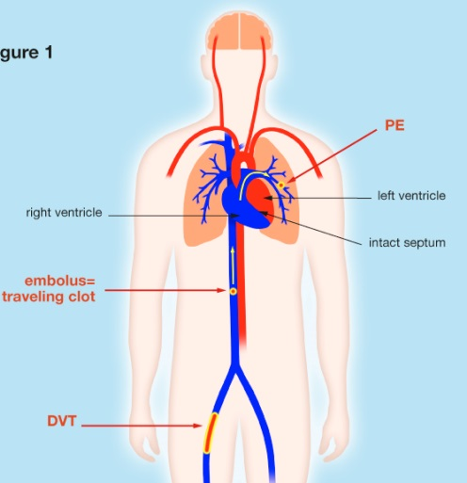
Thrombophilia (sometimes hypercoagulability or a prothrombotic state) is an abnormality of blood coagulation that increases the risk of thrombosis (blood clots in blood vessels)
Thrombosis
Signs and symptoms
Disease definition
Thrombosis is the formation of a blood clot (thrombus) inside a blood vessel, obstructing the flow of blood through the circulatory system. When a blood vessel is injured, the body uses platelets and fibrin to form a blood clot, because the first step in repairing it (hemostasis) is to prevent loss of blood. If that mechanism causes too much clotting, and the clot breaks free, an embolus is formed
Thromboembolism is both thrombosis and its main complication, which is embolus
Signs and symptoms
Thrombophilia cause no specific symptoms other than those related to clotting events
The most common conditions associated with thrombophilia are deep vein thrombosis (DVT) and pulmonary embolism (PE). DVT usually occurs in the legs, and is characterized by pain, swelling and redness of the limb. It may lead to long-term swelling and heaviness due to damage to valves in the veins. The clot may also break off and migrate (embolize) to arteries in the lungs. Depending on the size and the location of the clot, this may lead to sudden-onset shortness of breath, chest pain, palpitations and may be complicated by collapse, shock and cardiac arrest
Source: IMS Consulting; News-Medical.Net

Slide 25
Both inherited and acquired reasons can lead to thrombophilia, considered the most important causes of thrombosis
Thrombosis
Causes and Pathophysiology
Causes
Pathophysiology
In classical terms, thrombosis is caused by abnormalities in one or more of the following (Virchow's triad):
The composition of the blood (hypercoagulability or thrombophilia)
Quality of the vessel wall (endothelial cell injury). The main mechanism is exposure of tissue factor to the blood coagulation system
Nature of the blood flow (stasis, turbulence). Causes of disturbed blood flow include stagnation of blood flow past the point of injury, or venous stasis which may occur in heart failure
Inherited Causes are related to a genetically determined tendency for VTE that characteristically occurs at a young age with or without an apparent cause, and with a tendency to recur
Increased Levels of Procoagulants
Decreased Levels of Anticoagulants
Abnormal Fibrinolysis
Other Inherited Causes
Acquired Causes
Autoimmune disorders
Pregnancy
Hormone therapy
Malignancy
Myeloproliferative disorders
Heparin-induced thrombocytopenia
Immobilization
Source: IMS Consulting; Indiana Hemophilia & Thrombosis Center

Slide 26
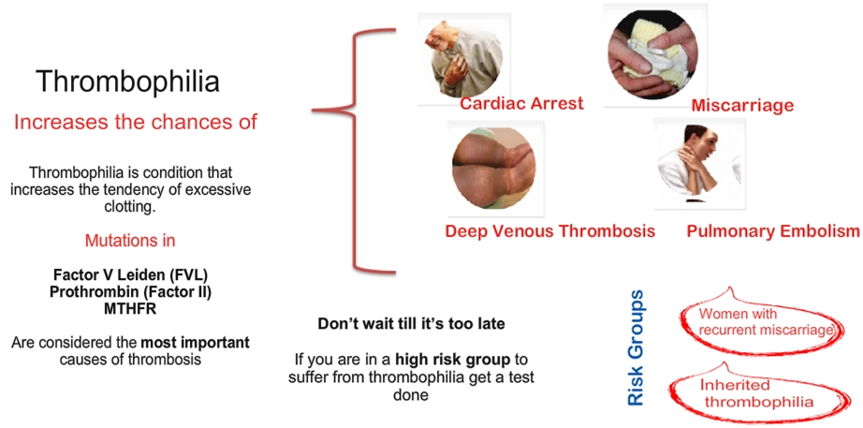
Thrombophilia increases the chances of cardiac arrest, deep venous thrombosis, miscarriage and pulmonary embolism
Thrombosis
Causes and Pathophysiology

Slide 27
There are two distinct forms of thrombosis, venous thrombosis and arterial thrombosis, each of which has several subtypes
Thrombosis
Classification and stage
Arterial Thrombosis
Venous
Thrombosis
Post ACS
Deep Vein Thrombosis (DVT)
PCI
Pulmonary Embolism (PE)
Post Stroke
Superficial Thrombophlebitis
Atrial
Fibrillation
Peripheral arterial disease (PAD)
Source: IMS Consulting; American Heart Associations, 2007 China dyslipidemia treatment guideline

Slide 28
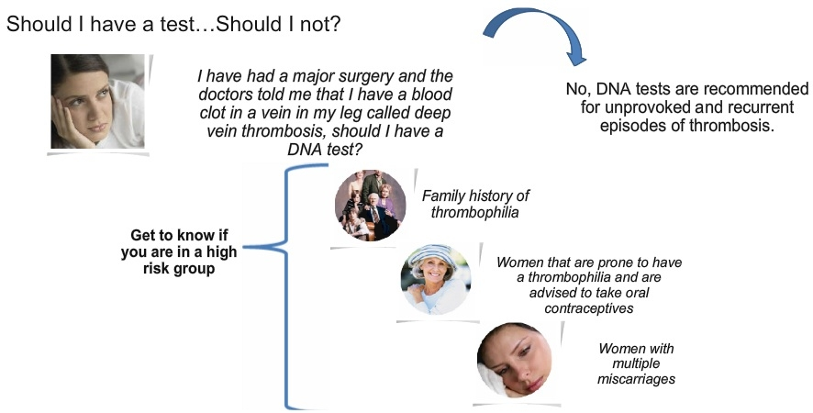
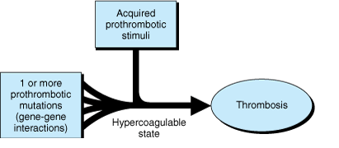
Imaging diagnosis is the gold standards for diagnosis of thrombosis, but only high risk group of unprovoked episode of thrombosis needs DNA test
Thrombosis
Diagnosis
There are divergent views as to whether everyone with an unprovoked episode of thrombosis should be investigated for thrombophilia
Imaging diagnosis (e.g. Venography and pulmonary angiography) remain the gold standards for diagnosis of thrombosis, respectively, but these tests are now increasingly supplanted by less invasive and less costly procedures
Tests for thrombophilia include complete blood count (with examination of the blood film), prothrombin time, partial thromboplastin time, thrombodynamics test, thrombin time and reptilase time, lupus anticoagulant, anti-cardiolipin antibody, anti-β2 glycoprotein antibody, activated protein C resistance, fibrinogen tests, factor V Leiden and prothrombin mutation, and basal homocysteine levels

Slide 29
Antiplatelets are recommended for arterial thrombosis patients as 1st line treatment, while anti-coagulants are mainly for venous ones
Thrombosis
Medication
Anti-thrombosis treatment
First Line
Second line
Post ACS
Aspirin
Clopidogrel
LMWH
PCI
Clopidogrel
LMWH
GPIIb/IIIa inhibitors
Arterial
Thrombosis
Post Stroke
Aspirin
Clopidogrel
Atrial
Fibrillation
Warfarin
Aspirin
Clopidogrel
PAD
Clopidogrel
LMWH
DVT
LMWH
Aspirin
Venous
Thrombosis
PE
LMWH
Warfarin
Prophylaxis*
LMWH
Warfarin
ACS: acute coronary syndrome
PCI: Percutaneous coronary intervention
PAD:Peripheral Artery Disease
DVT: Deep vein thrombosis
PE: Pulmonary embolism
Anticoagulant
*Prophylaxis include major surgery, such as orthopedic surgeries;
Anti-platelet
Source: Chinese treatment guidelines

Slide 30
Thrombosis related diseases are common in China
Thrombosis
Epidemiology
Epidemiology of Thrombosis related diseases
Arterial Thrombosis
Prevalence or Incidence
Venous
Thrombosis
Prevalence or Incidence
Post ACS
MM
DVT
0.1
MM
PCI
PE
0.7
Post Stroke
Prophylaxis*
1.2
Atrial
Fibrillation
10.3
PAD
40.5
ACS: Acute coronary syndrome
PCI: Percutaneous coronary intervention
PAD:Peripheral Artery Disease
DVT: Deep vein thrombosis
PE: Pulmonary embolism
China population 2009: 1334.7 MM
* Prophylaxis include major surgery, such as orthopedic surgeries;
Source: An epidemiological survey of atrial fibrillation in China, Zhonghua Neike zazhi 2004; Percutaneous coronary intervention in mainland China in 2008: register results; China J Cardial, 2009, volume 37; American Heart Association 2006; Rising incidence of pulmonary embolism in modern China, 2006

Slide 31
China thrombosis market is huge and growing quickly, but the competition is fierce as Clopidogrel loses its patent and Gx pours into the market
Thrombosis
Market trend
Market Prospect
Product Segment
Competition
A series of diseases are related to thrombosis, including both arterial & venous problems
China’s thrombosis market has been growing very quickly, especially in PAI & Heparin treatment classes
The sheer death rate of these disease and hence government attention drive China market to quickly catch up with US and Japan
For anti-platelets, orals with two dominant molecules are squeezing commoditized injectables’ market share
For anti-coagulations, though Heparins have been upgraded to LMWHs, the segment is still waiting for strong oral drugs’ presence
MNCs and local Gx companies are wrestling with equal potency, but with different focuses
Number of Gx brands increased within most top molecules
Originators are playing in high-end market and Gx are playing in low-end
MNCs and Gx companies are playing in different Geo locations
Source: IMS Consulting; decision resource

Slide 32
Major disease area overview - Cardiovascular
Hypertension
Dyslipidemia
Thrombosis
Coronary Heart Disease
Stroke

Slide 33
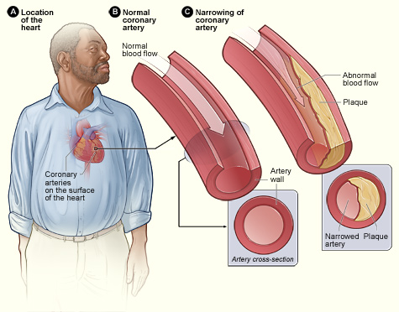
CHD is a disease with narrowing or blockage of coronary arteries and symbolized by angina and myocardial infarction among other symptoms
CHD
Signs and symptoms
Disease definition
Coronary heart disease (CHD) is a disease in which plaque builds up inside and narrow the coronary arteries (atherosclerosis) and impact oxygen-rich blood supply to heart muscle, which causes angina and heart attack
Signs and symptoms
CDH may be symptomatic or asymptomatic, occur with exertion or at rest, and culminate in a myocardial infarction, depending on obstruction severity and the rapidity of development. Typical symptoms include:
Angina: Reduced oxygen-rich blood to heart muscle will cause angina
Myocardial infarction (MI)：In more serious situation, cut-off of blood supply will cause myocardial infarction
Heart failure & arrhythmias: Over time CHD can weaken heart muscle and lead to heart failure & arrhythmias
Sudden cardiac death
Other less serious symptoms include shortness of breath and fatigue with activity (exertion)
Source: IMS Consulting

Slide 34
CDH is usually caused by atherosclerosis, which is mostly related to unhealthy life style such as smoking and obesity
CHD
Causes and Pathophysiology
Causes
Pathophysiology
Coronary artery disease has a number of well determined risk factors. The most common include smoking, family history, hypertension, obesity, high alcohol consumption, lack of exercise, stress, and hyperlipidemia
Per US research, smoking is associated with about 50% of cases and obesity 20%. Lack of exercise has been linked to 7–12% of cases. Job stress appear to play a minor role accounting for about 3% of cases
CDH is most commonly equated with atherosclerotic coronary artery disease, but coronary disease can be due to other causes, such as coronary vasospasm
CHD is a chronic process that begins during adolescence and slowly progresses throughout life. The risk factors accelerate or modify a complex and chronic inflammatory vascular process that ultimately manifests as fibrous atherosclerotic plaque
Fatty material and other substances form a plaque build-up on the walls of coronary arteries
This buildup causes the arteries to get narrow, and restrict blood flow to heart muscle by physically clogging the artery or by causing abnormal artery function
Without an adequate blood supply, the heart becomes starved of oxygen and the vital nutrients it needs to work properly, which can cause chest pain or heart attack
Prognosis
The main adverse outcomes are unstable angina, MI, and sudden death due to arrhythmias
Women with CHD tend to have a worse prognosis. Mortality rate increases significantly with systolic hypertension, abnormal ECG (electrocardiograph) and diabetes
Source: US CDC

Slide 35
CDH is categorized into 2 major sub-types according to different symptoms and severity
CHD
Classification
Category | Sub-category | Definition | Symptoms
Chronic Coronary Artery Disease (CAD) | Angina Pectoris | Angina pectoris is a clinical syndrome of precordial discomfort or pressure due to transient myocardial ischemia without infarction | Angina may be a vague, barely troublesome ache or may rapidly become a severe, intense precordial crushing sensation. It is rarely described as pain Discomfort is most commonly felt beneath the sternum, although location varies
 | Others | Syndrome X: Cardiac microvascular dysfunction or constriction causing angina Silent Ischemia: Some patients with CAD (particularly patients with diabetes) may have ischemia without symptoms
Acute Coronary Syndrome(ACS) | Unstable angina | Rest angina that is prolonged (>20 min) New-onset angina of at least class 3 severity in the Canadian Cardiovascular Society classification Increasing angina (previously diagnosed angina becoming more frequent, more severe, longer, or lower in threshold) | Symptoms are those of angina pectoris, except that the pain or discomfort of unstable angina usually is more intense, lasts longer, is precipitated by less exertion, occurs spontaneously at rest, is progressive (crescendo) in nature, or involves any combination of these features
 | Non–ST-segment elevation MI (NSTEMI) | Myocardial Necrosis (evidenced by cardiac markers in blood; troponin I or troponin T and CK will be elevated) without acute ST-segment elevation or Q waves. ECG changes such as ST-segment depression, T-wave inversion, or both may be present | Symptoms of NSTEMI/STEMI are the same Days to weeks before the event, 2/3 of patients experience prodromal symptoms, including unstable or crescendo angina, shortness of breath, and fatigue Usually, the first symptom of infarction is deep, substernal, visceral pain described as aching or pressure. The pain is similar to angina pectoris but is usually more severe and long-lasting Some patients present with syncope Distinguishing NSTEMI and STEMI is useful because prognosis and treatment are different.
 | ST-segment elevation MI (STEMI) | Myocardial necrosis with ECG changes showing ST-segment elevation that is not quickly reversed by nitroglycerin or showing new left bundle branch block. Q waves may be present. Cardiac markers, troponin I or troponin T, and CK are elevated
 | Sudden cardiac death | Sudden death due to myocardial dysfunction (e.g. arrhythmias) caused by ACS
Source: Merck manual for health care professionals; US & China Chronic Angina Guideline

Slide 36
Golden standard of CHD diagnosis is coronary angiography but it is not always necessary as it is an invasive procedure; many other noninvasive methods have shown to be valuable
CHD
Diagnosis
History & symptoms
Diagnosis is suspected if chest discomfort is typical and precipitated by exertion and relieved by rest. Presence of significant risk factors adds weight to reported symptoms
ECG
With typical symptoms present, ECG is indicated. Because angina resolves quickly with rest, ECG rarely can be done during an attack except during stress testing. Between attacks, ECG shows evidence in ~70% patient of previous infarction, hypertrophy, or nonspecific ST-segment and T-wave (ST-T) abnormalities. An abnormal resting ECG alone does not establish or refute the diagnosis
Stress testing
Tests include stress testing with ECG or with imaging and coronary angiography. Noninvasive tests are considered first. The most accurate tests are stress echocardiography and myocardial perfusion imaging with single-photon emission CT or PET
Diagnosis
Coronary angiography
It is the standard diagnosis but not always necessary. It is indicated primarily to locate and assess severity of coronary artery lesions when revascularization is being considered. Obstruction is assumed to be significant when the luminal diameter is reduced > 70%
Electron beam CT imaging
Electron beam CT can detect the amount of Ca present in coronary artery plaque. The Ca score is roughly proportional to risk of subsequent coronary events. However the score does not correlate well with the need for angioplasty or CABG and only for reference purpose
MDRCT coronary angiography
Multidetector row CT (MDRCT) coronary angiography can accurately identify coronary stenosis. However, radiation exposure is significant, and the test is not suitable for certain groups of patients
Basic lab testing
Basic lab testing to understanding the risk factors, incl. glucose, HDL-C, LDL-C and TG, and other relevant testing such as anemia test, CTnT, etc.
Source: Merck manual for health care professionals; US & China Chronic Angina Guideline

Slide 37
Life style should change to modify risk factors; drugs are used to relieve acute symptoms, prevent/reduce ischemia; surgery is conducted if symptoms persist despite medical therapy
CHD
Treatment
CHD Treatment
Surgery
Medication
Life style change
Target is that reversible risk factors are modified as much as possible
Lifestyle changes (incl. diet, weight control, smoking cessation, etc.) have been shown to be effective in reducing (and in the case of diet, reversing) coronary disease
The main goals of medication are to relieve acute symptoms, prevent or reduce ischemia, and prevent future ischemic events. Most common drugs include:
Antiplatelet drugs (aspirin and/or clopidogrel or ticagrelor)
Liquid lowering agent (statin)
ACE inhibitors
beta-blockers
Nitroglycerin
Calcium channel blockers
Revascularization, either with PCI (eg, angioplasty, stenting) or CABG should be considered if angina persists despite drug therapy and worsens quality of life or if anatomic lesions put a patient at high risk of mortality
PCI is usually preferred for 1/2-vessel disease with suitable anatomic lesions and is increasingly being used for 3-vessel disease
CABG is very effective in selected patients with angina. The ideal candidate has severe angina pectoris and localized disease, or diabetes mellitus

Slide 38
CHD medication market is a combination of drugs targeting various relevant indication/disease, e.g. lipid disorder & hypertension; device (stent) is more specifically designed for CHD
CHD
Treatment
CHD market is segmented to medication and surgery treatment
Medication Market
Device Market
Patients with CHD generally suffer from other co-morbidity, such as hypertension, lipid disorder, and the medication applied in CHD treatment is mostly related to these relevant indications. Therefore it is difficult to isolate the CHD medication market
Currently many of the related drug categories are facing intense competition from generics, with recent patent expiration of several blockbuster such as Lipitor/Plavix. The market prospect remains to be tested through more detailed research
On the other hand, PCI surgery device market has been booming for the years:
PCI surgery volume is estimated to be over 300k cases in 2012
The most valuable and therefore promoted devices in PCI surgery are stent, which is priced between Rmb ~10k to over Rmb 30k
3 local players (Weigao, Bejing Lepu and Shanghai Weichuang) are dominating the stent market with lower-priced products, accounting for 70% of market share in 2008
Stent price has been adjusted due to pressure of government tender, which impacts the growth prospect of this market
Market
Segment
Source: Desktop research

Slide 39
Pharmacotherapy is either focused on improving long term prognosis (i.e. prevent MI & death) or on reducing angina symptoms and ischemia occurrence
CHD
Medication
Improve Prognosis
Symptom Relief
Antiplatelet drugs
β-Blockers
Nitroglycerin & Nitrates
Aspirin exerts an antithrombotic effect by inhibiting cyclooxygenase and synthesis of platelet thromboxane A2
Clopidogrel blocks adenosine diphosphate–dependent activation of the glycoprotein IIb/IIIa complex. In a randomized trial that compared clopidogrel with aspirin in patients with previous MI, stroke, or symptomatic peripheral vascular disease, clopidogrel appeared to be slightly more effective than aspirin in decreasing the combined risk of MI, vascular death, or ischemic stroke
MOA: Decrease in heart rate, contractility and arterial pressure with beta-blockers is associated with decreased myocardial oxygen demand. A reduction in heart rate also increases diastolic perfusion time, which may enhance LV perfusion
Clinical effectiveness: Various types of beta-blockers (e.g. propranolol, metoprolol) are available for treatment of hypertension and angina。 They appear to be equally effective in angina pectoris
Nitrates are vasodilators that produce beneficial effects by both reducing the myocardial oxygen requirement and improving myocardial perfusion
In patients with exertional stable angina, nitrates improve exercise tolerance, time to onset, and ST-segment depression. In combination with β-blockers or Ca antagonists, nitrates produce greater antianginal effects in patients with stable angina
Lipid lowering agent
ACE Inhibitor
Calcium Antagonist
Clinical trials have documented that LDL-lowering agents (statin) can decrease risk of adverse ischemic events in patients with established CHD
LDL-C lowering target should be less than 100 mg/dL, and for high-risk patients the target should be <80mg/dL
It has been suggested that ACEi may in some way slow down the progress of atherosclerosis
Results of many trials confirm that use of the ACEi (ramipril & perindopril) reduced cardiovascular death, MI, and stroke in patients
Calcium antagonists (dihydropyridine, nondihydropyridine) drugs such as verapamil and diltiazem, decrease coronary vascular resistance and increase coronary blood flow
Dilation of the epicardial coronary arteries is the principal mechanism of the beneficial effect of calcium antagonists for relieving vasospastic angina
Source: US and China Chronic Angina Guideline

Slide 40
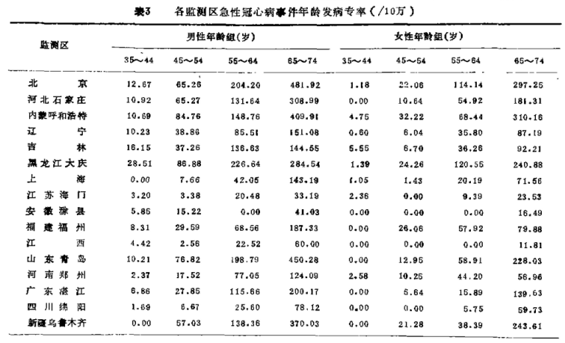
There is no updated epidemiology research of CHD population, but it is estimated to be quickly rising due to urbanization and the consequently unhealthy life style
CHD
Epidemiology
The most recent large scale ACS epidemiology survey (WHO MONICA) in China was launched in 1993 in 16 regions (province/city), which had the following observation:
Incidence rate: North > South, Male > female,
Urban population > Rural (e.g. incidence rate for
Shijiazhuang urban region is 186 vs. 60 in urban)
Mortality rate within 4 weeks was very high (e.g. 72%
for male and 66% for female in Shanghai)
The conclusion was that in 1990s incidence rate was
relatively low compared to western country, but
mortality rate was rather high due to less developed
healthcare infrastructure and disease awareness
More recent update
“Incidence risk is quickly rising from 1998 to 2008, and we estimated a 26.1% increase for Chinese male population and 19% increase for female”
Professor Wu Yangfeng, Puwai Hospital
In 1990s, mortality rate for urban male CHD patient was 49.2/100k, and 32.2 for female (Internal Medicine, 7th edition, 2007)
It is estimated that CHD patients in China have reached 20 mn, with 1m new cases every year
Source: 1993 MONICA Survey, CKNI database

Slide 41
Unmet needs in CHD are mostly concentrated on disease prevention and abuse of PCI & stent
CHD
Unmet needs
Unmet needs of patient
Unmet needs of the medical community
More effective diagnosis and primary prevention
Better symptom control
Fewer exacerbations
Slowing of disease progression
Better life expectancy
Decrease abuse of PCI & stent
Lower price of stent
Optimizing disease prevention
Preventing exacerbations and decreasing their clinical impact
Improve treatment and prognosis of acute coronary syndrome
Unmet needs in CHD
Source: Desktop research

Slide 42
Major disease area overview - Cardiovascular
Hypertension
Dyslipidemia
Thrombosis
Coronary Heart Disease
Stroke

Slide 43
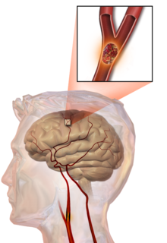
Stroke is defined as rapid loss of brain function due to disturbance in the blood supply to the brain
Stroke
Definition and symptoms
Disease definition
A stroke is the rapid loss of brain function due to disturbance in the blood supply to the brain. It has high fatality rate and disability rate.
Signs and symptoms
Precursors: Dizziness, limbs anesthesia, sudden blackout, fall without clear reasons, abnormal speech, and yawn not related to sleeplessness
Classic symptoms: Hemiplegia and muscle weakness of the face, numbness, reduction in sensory or vibratory sensation, balance problem, etc.
Risk factors
Unmodifiable factor: Age (The older, the riskier) and gender (Prevalence of male is higher than that of female)
Modifiable factor: High blood pressure, smoking, diabetes, atrial fibrillation, high blood cholesterol levels, etc.
Illustration of an embolic stroke, showing a lockage lodged in a blood vessel
Source: IMS Consulting;2011 中国卒中一级预防指南

Slide 44
Stroke is mainly classified into ischemic stroke and hemorrhagic stroke, but ischemic stroke is the most common type in China
Stroke
Classification
Approximate Breakdown of Types of Stroke
Stroke Types
Stroke Causes
Embolism
80%
Cerebral Atherothrombosis
10%
Ischemic Stroke
70%
Lacunar
5％
Infarction of unknown cause* 5%
All Stroke
Brain Hemorrhage
80％
Hemorrhagic Stroke 25%
Subarachnoid Hemorrhage
20％
Other Mix Types 5%
*Many infarctions of unknown cause are thought to be caused by embolism
Source: IMS project experience

Slide 45
Stroke patients in China are usually diagnosed by neurologists and diagnosis is high due to familiarity of stroke symptoms by neurologists
Stroke
Diagnosis
Diagnosis Path for Stroke
Patients have aphasia, semi-paralysis, headache, dizziness, vertigo and numbness
Neurology Department
Routine Tests:
Get medical history
Physical & neurological examination
Laboratory (blood) tests
CT scan
Study the results of other diagnostic tests that might be needed
More Tests for Treatment Purpose:
Digital Subtraction Angiography (DSA)
Magnetic Resonance Iimaging (MRI)
Transcranial Doppler (TCD)
Ischemic Stroke
Hemorrhagic Stroke
Other Mix Types
Source: IMS project experience

Slide 46
Treatments depend on treatment time window; Generally, combined therapies are adopted
Stroke
Treatment
Time Window
Therapies
Key Products
Thrombolytic Treatment
Activase (rt-PA). Urokinase is regarded as a substitute thrombolytic therapy in China
0-6 hours
Cerebral Protection
Cerebral protective therapies
1-3%
Antiplatelets
(long-term use)
Aspirin, ozagrel and clopidogrel
Antiplatelets
(long-term use)
Aspirin, ozagrel and clopidogrel
Anticoagulants
Unfractionated Herparin (UFH) and low molecular weight Heparin (LMWH)
>6 Hours
Cerebral Protection
Edaravone (Bi Cun), dl-NBP (NBP) and TCMs such as Hong Hua, Dan Sen etc
99-97%
Microcirculation Improving
Cinepazide Maleate (Ke Lin Ao), Ginkgo, Batroxobin (Dong Ling Di Fu), dl-NBP (NBP) and TCM
Anti-hyperlipidemia (long-term use)
Statins
Source: IMS project experience

Slide 47
China has large stroke patient population, with an increasing prevalence rate
Stroke
Epidemiology
Prevalence of stroke in China
Mn population
China has ~7 million stroke patient population in 2008, with estimated growth of 16% till 2013
The incidence of stroke is ~1.5-2 million in China
The prevalence rate is estimated to increase because of increasing aging population, and more unhealthy lifestyle
Prevalence of stroke is higher in urban areas than in rural areas due to more unhealthy and westernized lifestyle
16%
2008
2009
2013e
Source: IMS project experience

Slide 48
Efficacy and treatment cost are two major unmet needs in stroke
Stroke
Unmet needs
Efficacy
There are no effective products to treat stroke sequelae
If patients are not treated within 6 hours of stroke, no products can reverse the damages: Recombinant human tissue-type plasminogen activator (rt-PA) is the only FDA approved therapy
No products can reverse atherosclerosis or to treat the underlying problem. Current treatments can only reduce stroke risk.
Lack of products to prevent follow-on stroke:
~30% patients who have suffered a stroke with experience another stroke
Unmet needs in Stroke
Treatment Cost
Long-term treatments are very costly for patients: Many long-term treatment options require steep co-pays
Source: IMS project experience

